Slide 1

Module 16 - Application Case Study – Electrostatic Potential Calculation
Lecture 16.2 - Kernel Optimization

Slide 2
Objective
To learn how to apply parallel programming techniques to an application
A fast gather kernel
Thread coarsening for more work efficiency and better performance
Memory access locality and pre-computation techniques

Slide 3
A Slower Sequential C Version
void cenergy(float *energygrid, dim3 grid, float gridspacing, float z, const float *atoms, int numatoms) {
int atomarrdim = numatoms * 4;
int k = z / gridspacing;
for (int j=0; j<grid.y; j++) {
float y = gridspacing * (float) j;
for (int i=0; i<grid.x; i++) {
float x = gridspacing * (float) i;
float energy = 0.0f;
for (int n=0; n<atomarrdim; n+=4) { // calculate potential contribution of each atom
float dx = x - atoms[n ];
float dy = y - atoms[n+1];
float dz = z - atoms[n+2];
energy += atoms[n+3] / sqrtf(dx*dx + dy*dy + dz*dz);
}
energygrid[grid.x*grid.y*k + grid.x*j + i] += energy;
}
}
}
Output oriented.

Slide 4
A Slower Sequential C Version
void cenergy(float *energygrid, dim3 grid, float gridspacing, float z, const float *atoms, int numatoms) {
int atomarrdim = numatoms * 4;
int k = z / gridspacing;
for (int j=0; j<grid.y; j++) {
float y = gridspacing * (float) j;
for (int i=0; i<grid.x; i++) {
float x = gridspacing * (float) i;
float energy = 0.0f
for (int n=0; n<atomarrdim; n+=4) {
// calculate potential contribution of each atom
float dx = x - atoms[n ];
float dy = y - atoms[n+1];
float dz = z - atoms[n+2];
energy += atoms[n+3] / sqrtf(dx*dx + dy*dy + dz*dz);
}
energygrid[grid.x*grid.y*k + grid.x*j + i] += energy;
}
}
}
More redundant work.

Slide 5
Pros and Cons of the Slower Sequential Code
Pros
Fewer accesses to the energygrid array
Cons
Many more calculations on the coordinates
More accesses to the atom array
Overall, slower sequential execution due to the sheer number of calculations performed

Slide 6
Output-Oriented DCS CUDA Block/Grid Design
:
Grid of thread blocks
Thread blocks:
64-256 threads
0,0
0,1
…
1,0
1,1
…
Threads compute
1 potential each
…
…
…

Slide 7
Gather Parallelization
in
Thread 1
Thread 2
…
out

Slide 8
A Fast DCS CUDA Gather Kernel
void __global__ cenergy(float *energygrid, dim3 grid, float gridspacing, float z, float *atoms, int numatoms) {
int i = blockIdx.x * blockDim.x + threadIdx.x;
int j = blockIdx.y * blockDim.y + threadIdx.y;
int atomarrdim = numatoms * 4;
int k = z / gridspacing;
float y = gridspacing * (float) j;
float x = gridspacing * (float) i;
float energy = 0.0f;
for (int n=0; n<atomarrdim; n+=4) { // calculate potential contribution of each atom
float dx = x - atoms[n ];
float dy = y - atoms[n+1];
float dz = z - atoms[n+2];
energy += atoms[n+3] / sqrtf(dx*dx + dy*dy + dz*dz);
}
energygrid[grid.x*grid.y*k + grid.x*j + i] += energy;
}
One thread per grid point

Slide 9
A Fast DCS CUDA Gather Kernel
void __global__ cenergy(float *energygrid, dim3 grid, float gridspacing, float z, float *atoms, int numatoms) {
int i = blockIdx.x * blockDim.x + threadIdx.x;
int j = blockIdx.y * blockDim.y + threadIdx.y;
int atomarrdim = numatoms * 4;
int k = z / gridspacing;
float y = gridspacing * (float) j;
float x = gridspacing * (float) i;
float energy = 0.0f;
for (int n=0; n<atomarrdim; n+=4) { // calculate potential contribution of each atom
float dx = x - atoms[n ];
float dy = y - atoms[n+1];
float dz = z - atoms[n+2];
energy += atoms[n+3] / sqrtf(dx*dx + dy*dy + dz*dz);
}
energygrid[grid.x*grid.y*k + grid.x*j + i] += energy;
}
All threads access all atoms.
Consolidated writes to grid points

Slide 10
Some Comments
Gather kernel is much faster than a scatter kernel
No serialization due to atomic operations
Compute-efficient sequential algorithm does not translate into the fast parallel algorithm
Gather vs. scatter is a big factor
But we will come back to this point later!

Slide 11
More Comments
In modern CPUs, cache effectiveness is often more important than compute efficiency
The input oriented (scatter) sequential code actually has bad cache performance
energygrid[] is a very large array, typically 20X or more larger than atom[]
The input oriented sequential code sweeps through the large data structure for each atom, wiping out data from the cache before they can be reused.

Slide 12
Outline of A Fast Sequential Code
for all atoms {pre-compute dz2 }
for all y {
for all atoms {pre-compute dy2 (+ dz2) }
for all x {
for all atoms {
compute contribution to current x,y,z point
using pre-computed dy2 + dz2
}
}
}

Slide 13
More Thoughts on Fast Sequential Code
Need temporary arrays for pre-calculated dz2 and dy2 + dz2 values
So, why does this code has better cache behaior on CPUs?

Slide 14
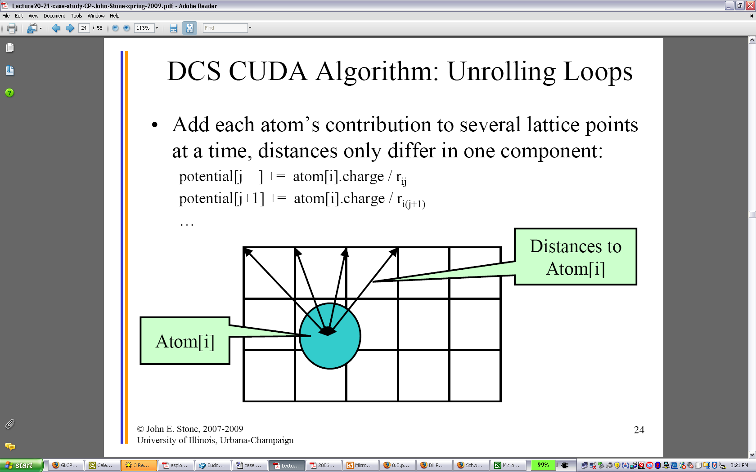
Pre-compution for More Computation Efficiency

Slide 15
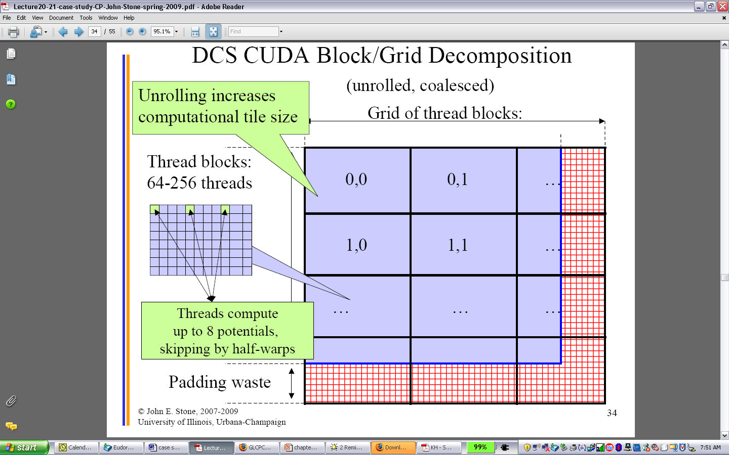
Thread Coarsening

Slide 16
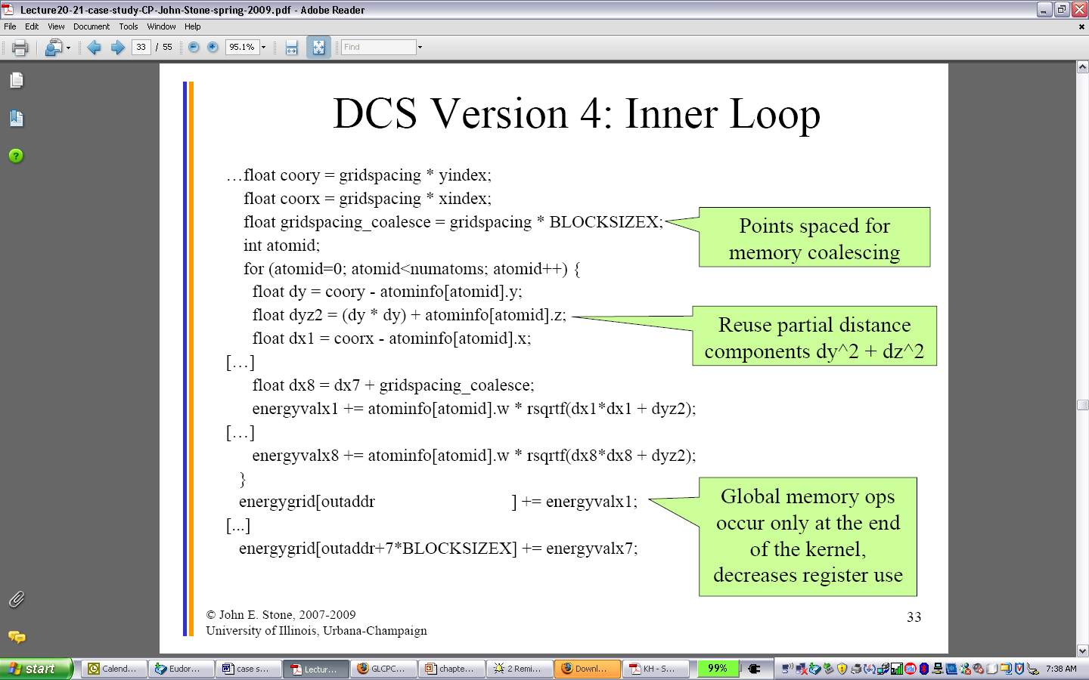
A Compute Efficient Gather Kernel

Slide 17
The GPU Teaching Kit is licensed by NVIDIA and the University of Illinois under the Creative Commons Attribution-NonCommercial 4.0 International License.

